Slide 1

CSE 350 Digital Electronics and Pulse Techniques
Analog to Digital Converter (ADC)
Course Instructor: Shomen Kundu (SDU)
Mail: shomen.kundu@bracu.ac.bd
Desk: #4N148

Slide 2
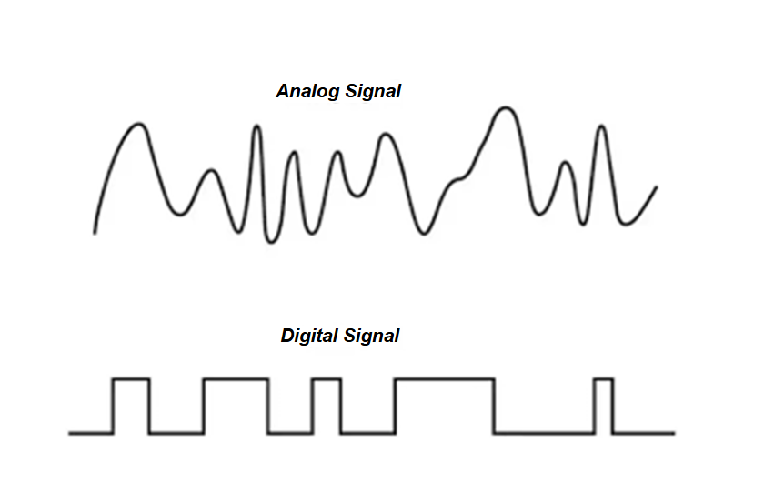
Analog to Digital Converter (ADC)
Signal can be classified into two broad categories.
Analog Signal ii. Digital Signal

Slide 3
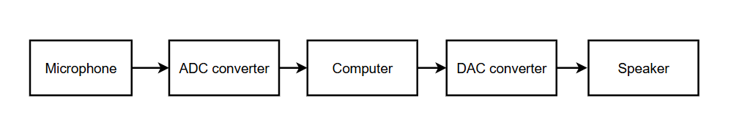
Analog to Digital Converter (ADC)
Physical world’s information are mostly analog. Analog means data could take
any real value at each instant of time.
In order to store/process we use digital data in our computers and microprocessor
Digital data means binary bit of strings.

Slide 4
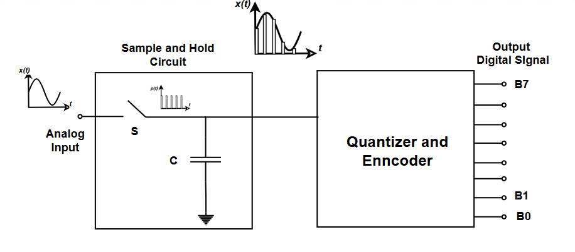
A/D conversion process

Slide 5
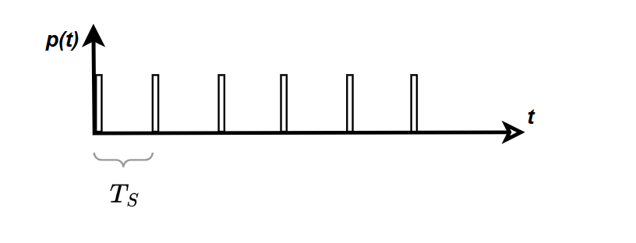
Sampling
Sampling is the process of converting a continuous-time signal into a discrete-time signal by taking measurements at specific intervals in time.
Pulse Train:

Slide 6

Sampling
Theorem: Sampling frequency should be greater than twice of signal frequency.
$$f_{s}>2∗f$$
$T_{s}=\frac{1}{f_{s}}$
Here, $f$ = the signal frequency
$f_{s}$ = the sampling frequency

Slide 7
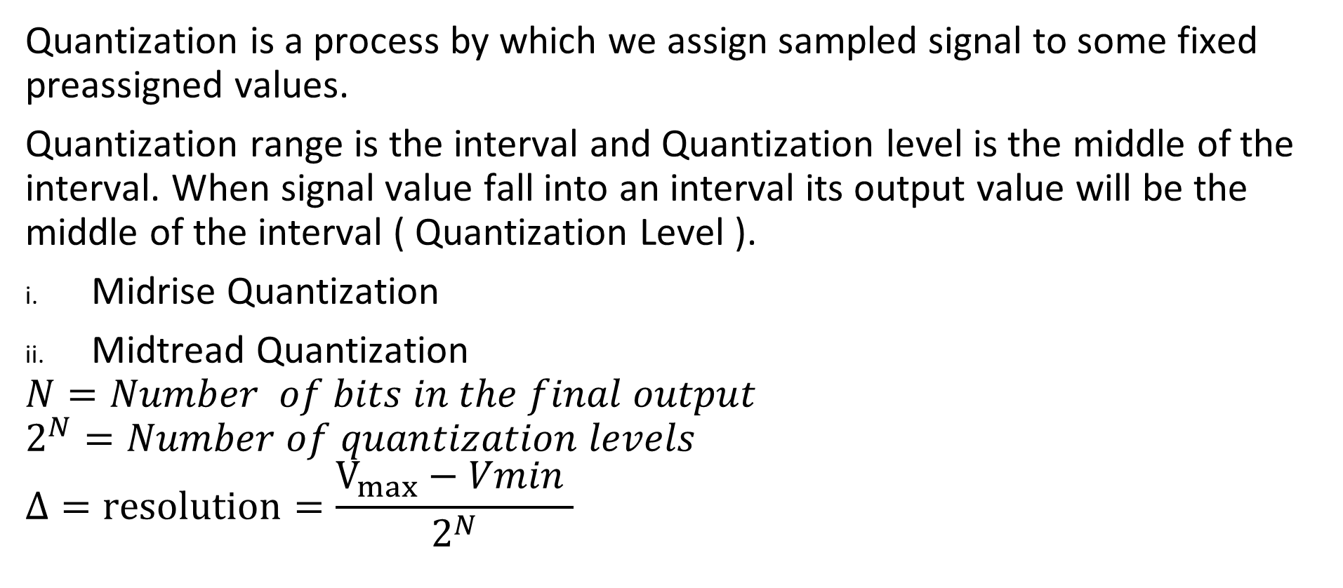
Quantization:
Quantization is a process by which we assign sampled signal to some fixed preassigned values.
Quantization range is the interval and Quantization level is the middle of the interval. When signal value fall into an interval its output value will be the middle of the interval ( Quantization Level ).
Midrise Quantization
Midtread Quantization
$$N=Number of bits in the final output$$
$$2^{N}=Number of quantization levels$$
$$Δ=resolution=\frac{V_{max}−Vmin }{2^{N}}$$

Slide 8
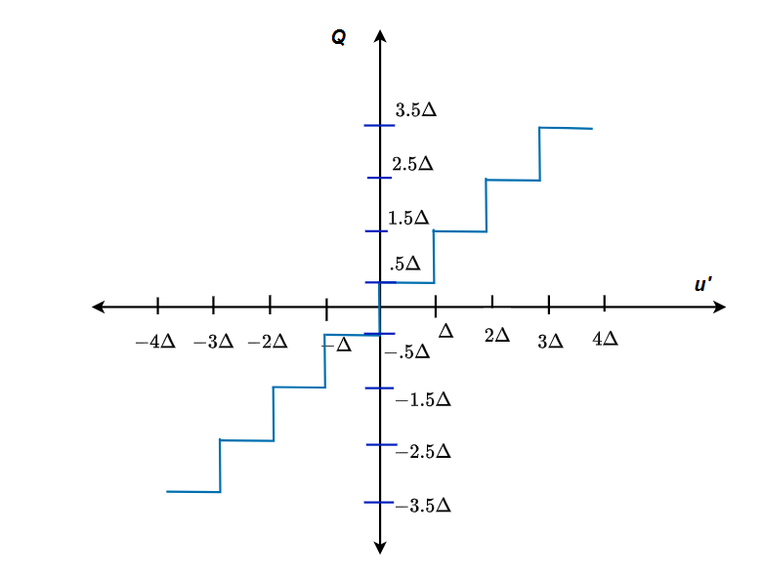

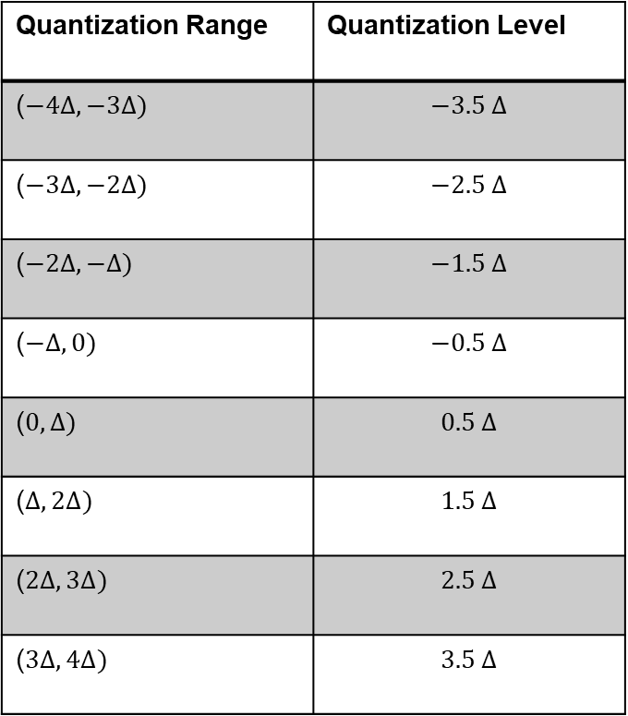
Midrise Quantization:
Quantization Range | Quantization Level
($−4∆, −3∆)$ | $$−3.5 ∆$$
($−3∆, −2∆)$ | $$−2.5 ∆$$
($−2∆, −∆)$ | $$−1.5 ∆$$
($−∆, 0)$ | $$−0.5 ∆$$
($0, ∆)$ | $$0.5 ∆$$
($∆, 2∆)$ | $$1.5 ∆$$
($2∆, 3∆)$ | $$2.5 ∆$$
($3∆, 4∆)$ | $$3.5 ∆$$
Here $∆$ is the resolution, you can assume any value of $∆.$
$V_{max}=4∆$ and $V_{min}=−4∆$

Slide 9
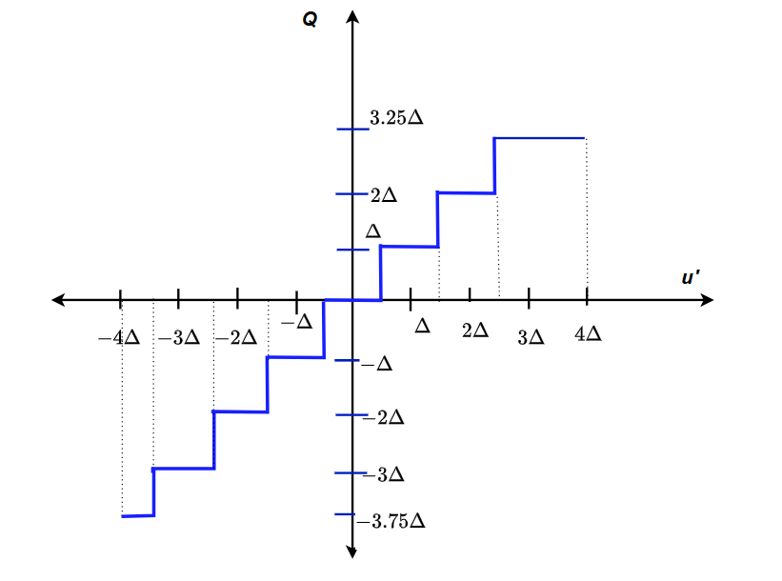
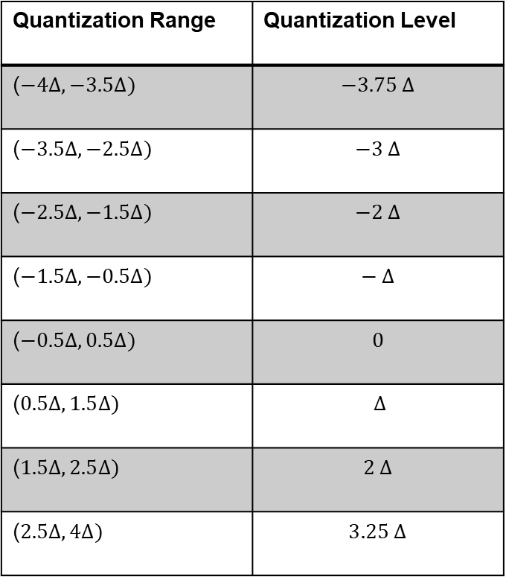
Mid tread Quantization ( Not symmetrical and Equally Spaced)
Quantization Range | Quantization Level
($−4∆, −3.5∆)$ | $$−3.75 ∆$$
($−3.5∆, −2.5∆)$ | $$−3 ∆$$
($−2.5∆, −1.5∆)$ | $$−2 ∆$$
($−1.5∆, −0.5∆)$ | $$− ∆$$
($−0.5∆, 0.5Δ)$ | $$0$$
($0.5Δ, 1.5∆)$ | $$∆$$
($1.5∆, 2.5∆)$ | $$2 ∆$$
($2.5∆, 4∆)$ | $$3.25 ∆$$
Here $∆$ is the resolution, you can assume any value of $∆.$
$V_{max}=4∆$ and $V_{min}=−4∆$

Slide 10

Encoding
We can choose binary values for each of the level.
$Number of bits=Ceil (log2\left( Number of levels \right))$
Assign lower Q level to 0
Then increase one for each next level ( Binary )

Slide 11
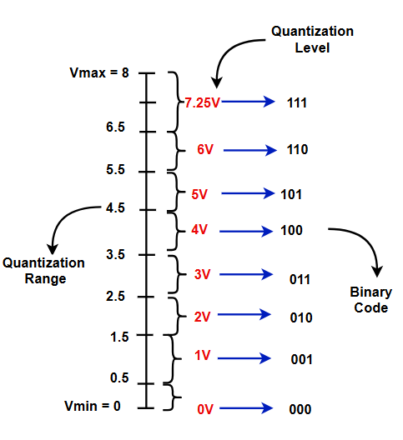
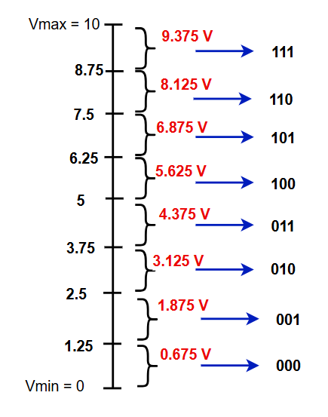
Quantization Range, Level, code
Ex: Identify which one is Mid rise and Mid tread.

Slide 12
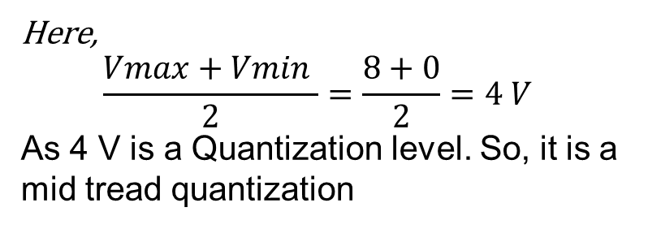
Quantization Range, Level, code
Here,
$$\frac{Vmax+Vmin }{2}=\frac{8+0}{2}=4 V$$
As 4 V is a Quantization level. So, it is a mid tread quantization

Slide 13
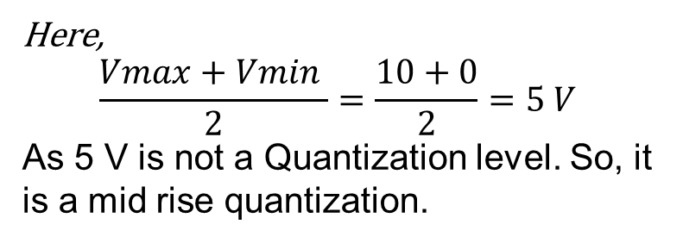
Quantization Range, Level, code
Ex: Identify which one is Mid rise and Mid tread.
Here,
$$\frac{Vmax+Vmin }{2}=\frac{10+0}{2}=5 V$$
As 5 V is not a Quantization level. So, it is a mid rise quantization.

Slide 14
Flash A/D converter
Features of the Flash A/D converter
This converter is very fast.
It requires one clock cycle to convert the analog to digital data.
It requires a lot components.

Slide 15
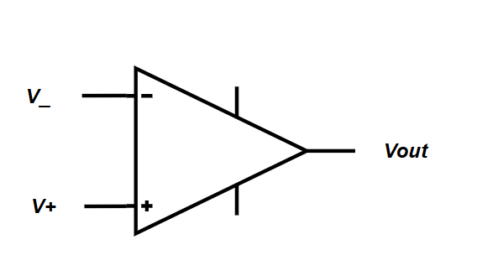

Op-Amp
For open loop configuration
$$If V_{+}>V_{−} , V_{out}=High (logic 1 )$$
$$If V_{+}<V_{−} , V_{out}=Low (logic 0 )$$

Slide 16
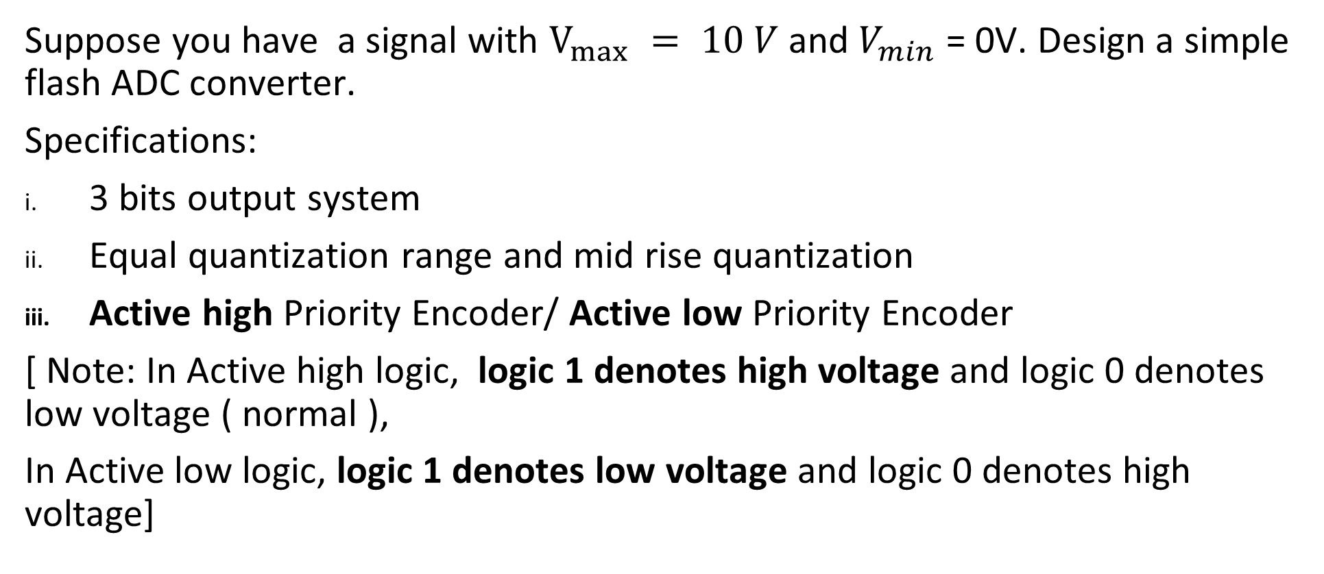
Flash ADC design
Suppose you have a signal with $V_{max} = 10 V$ and $V_{min}$ = 0V. Design a simple flash ADC converter.
Specifications:
3 bits output system
Equal quantization range and mid rise quantization
Active high Priority Encoder/ Active low Priority Encoder
[ Note: In Active high logic, logic 1 denotes high voltage and logic 0 denotes low voltage ( normal ),
In Active low logic, logic 1 denotes low voltage and logic 0 denotes high voltage]

Slide 17
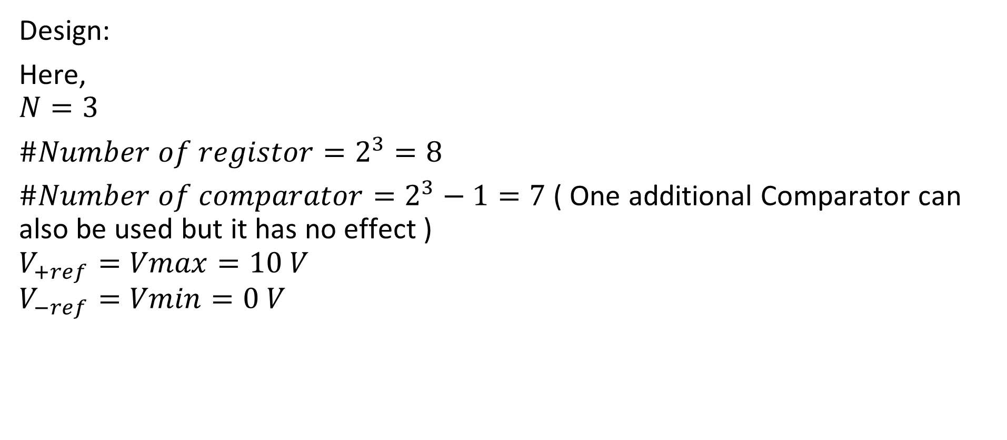
Flash ADC design
Design:
Here,
$$N=3$$
$\#Number of registor=2^{3}=8$
$\#Number of comparator=2^{3}−1=7$ ( One additional Comparator can also be used but it has no effect )
$$V_{+ref}=Vmax=10 V$$
$$V_{−ref}=Vmin=0 V$$

Slide 18
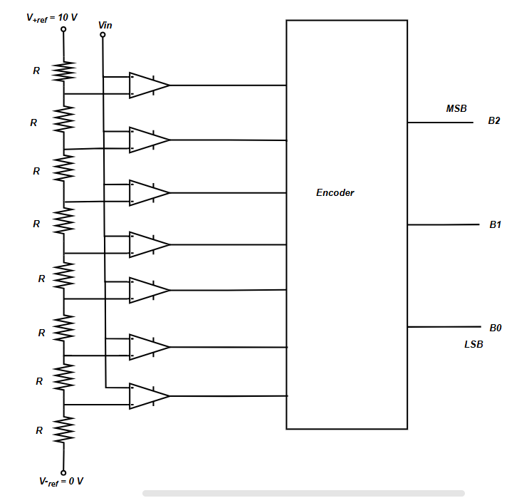
Circuit
The following is the Circuit of a 3 bits Flash ADC,
For active high priority encoder, V+ of the comparator is connected to the input.

Slide 19
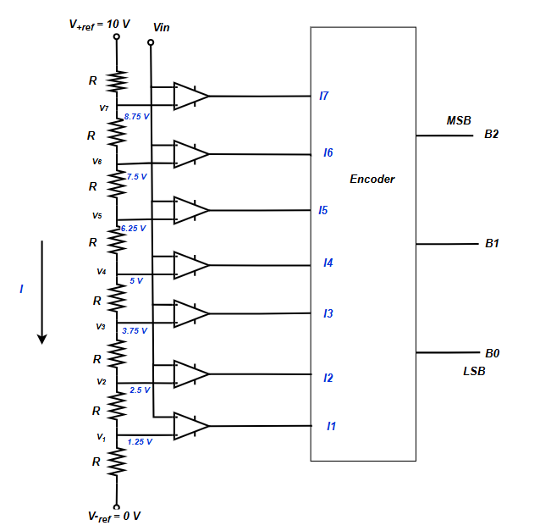
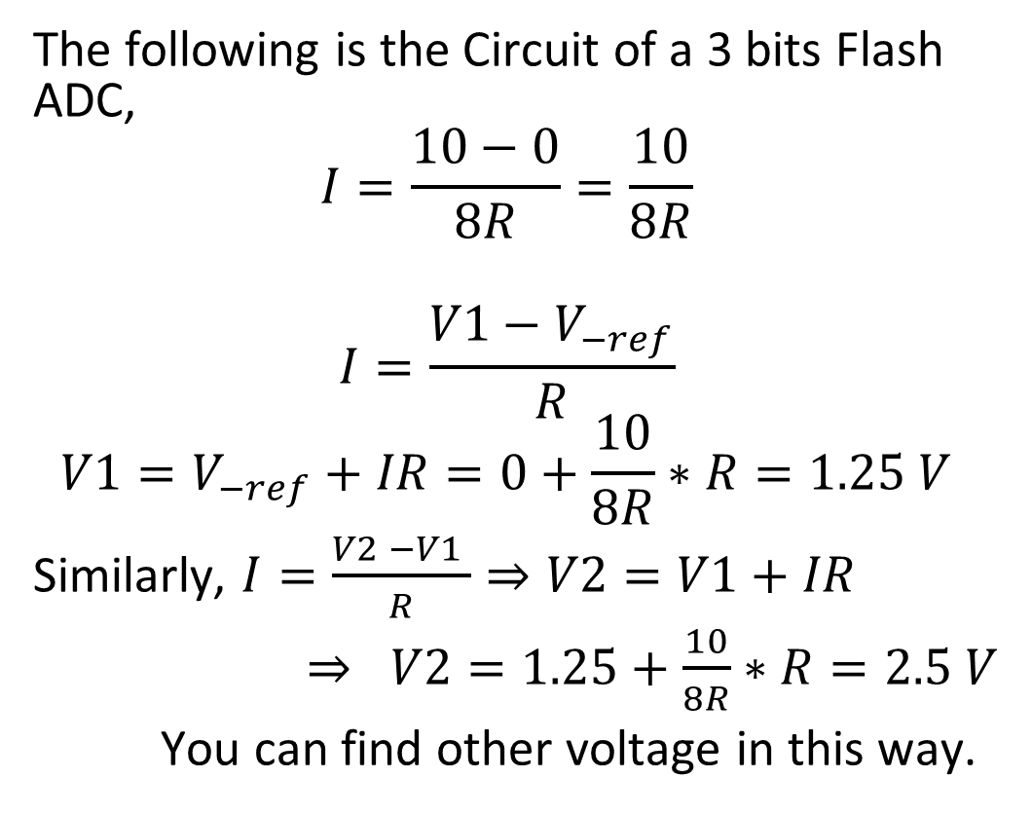
Circuit Analysis
The following is the Circuit of a 3 bits Flash ADC,
$$I=\frac{10−0}{8R}=\frac{10}{8R}$$
$$I=\frac{V1−V_{−ref}}{R}$$
$$V1=V_{−ref}+IR=0+\frac{10}{8R}∗R=1.25 V$$
Similarly, $I=\frac{V2 −V1 }{R}⇒V2=V1+IR$
$⇒ V2=1.25+\frac{10}{8R}∗R=2.5 V$
You can find other voltage in this way.

Slide 20
Circuit Analysis
Summary table:
Q Range | Q level | I7I6I5I4I3I2I1 | Binary (B2B1B0)
0 - 1.25 | 0.675 | 000 000 0
1.25 - 2.5 | 1.875 | 000 000 1
2.5 - 3.75 | 3.125 | 000 001 1
3.75 – 5 | 4.375 | 000 011 1
5 – 6.25 | 5.625 | 000 111 1
6.25 – 7.5 | 6.875 | 001 111 1
7.5 – 8.75 | 8.125 | 011 111 1
8.75 - 10 | 9.375 | 111 111 1

Slide 21
Circuit Analysis
Encoder Truth Table:
( V+ of the comparator is connected to the Input )
Encoder can be implemented using
the combinational network.
I7I6I5I4I3I2I1 | Binary (B2B1B0)
000 000 0 | 000
000 000 1 | 001
000 001 1 | 010
000 011 1 | 011
000 111 1 | 100
001 111 1 | 101
011 111 1 | 110
111 111 1 | 111

Slide 22
Circuit Analysis
Encoder Truth Table:
( For active low priority encoder V- of the comparator is connected to the Input )
Encoder can be implemented using
the combinational network.
I7I6I5I4I3I2I1 | Binary (B2B1B0)
111 111 1 | 000
111 111 0 | 001
111 110 0 | 010
111 100 0 | 011
111 000 0 | 100
110 000 0 | 101
1 000 000 | 110
000 000 0 | 111

Slide 23

Quantization Error
Quantization Error = |Signal value – Quantized vale|
Max Quantization Error = $∆/2$ ( $∆$ = resolution )

Slide 24
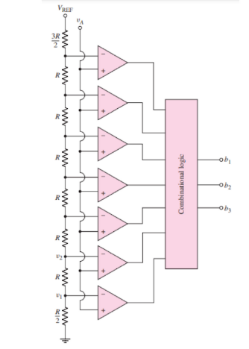
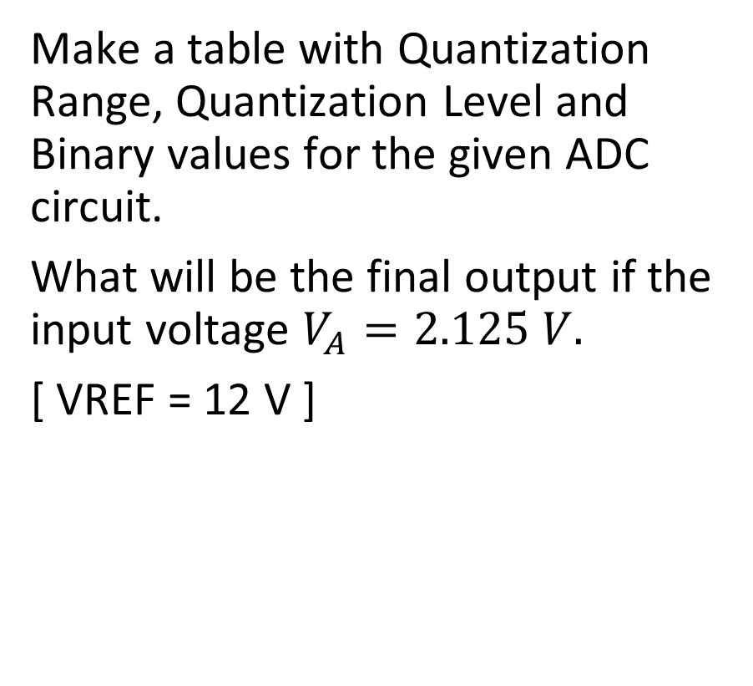
Problem:
Make a table with Quantization Range, Quantization Level and Binary values for the given ADC circuit.
What will be the final output if the input voltage $V_{A}=2.125 V.$
[ VREF = 12 V ]

Slide 25
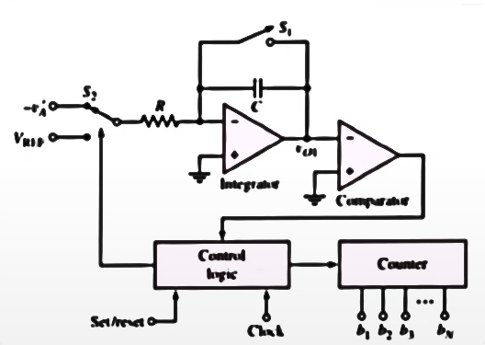
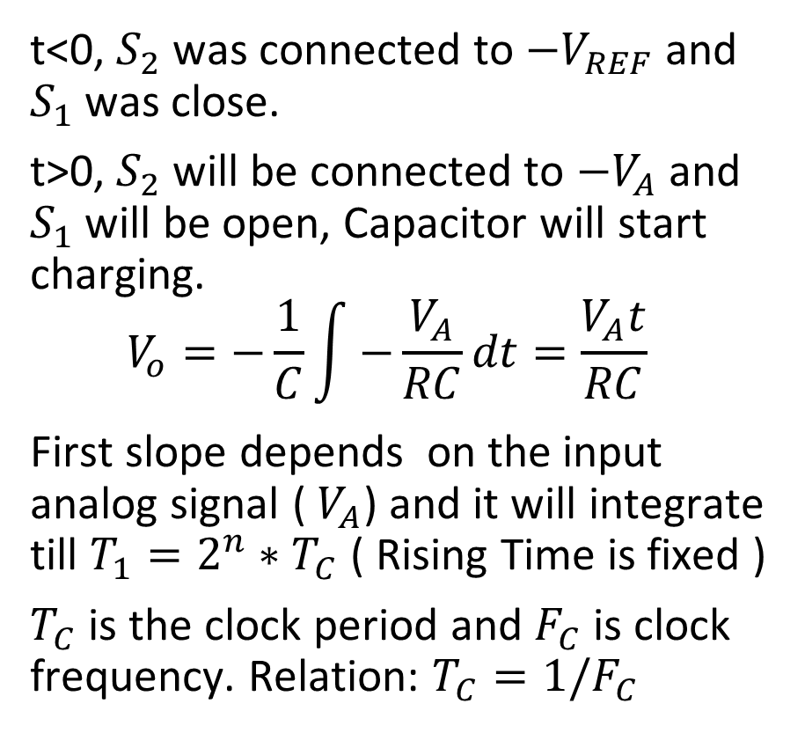
Dual Slope ADC
t<0, $S_{2}$ was connected to $−V_{REF}$ and $S_{1}$ was close.
t>0, $S_{2}$ will be connected to $−V_{A}$ and $S_{1}$ will be open, Capacitor will start charging.
$$V_{o}=−\frac{1}{C}\int{−\frac{V_{A}}{RC}dt}=\frac{V_{A}t}{RC}$$
First slope depends on the input analog signal ( $V_{A}$) and it will integrate till $T_{1}=2^{n}∗T_{C}$ ( Rising Time is fixed )
$T_{C}$ is the clock period and $F_{C}$ is clock frequency. Relation: $T_{C}=1/F_{C}$

Slide 26
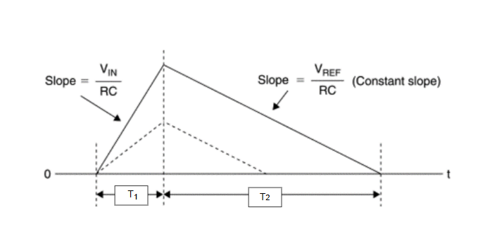
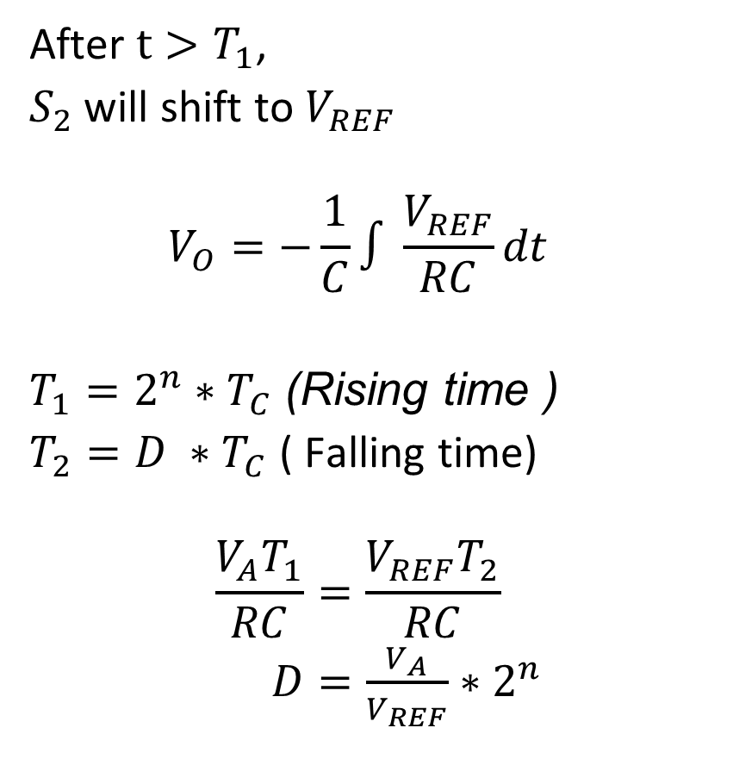
Dual Slope ADC
After $t>T_{1}$,
$S_{2}$ will shift to $V_{REF}$
$$V_{O}=−\frac{1}{C}∫\frac{V_{REF}}{RC}dt$$
$T_{1}=2^{n}∗T_{C}$(Rising time )
$T_{2}=D ∗T_{C}$ ( Falling time)
$$\frac{V_{A}T_{1}}{RC}=\frac{V_{REF}T_{2}}{RC}$$
$D=\frac{V_{A}}{V_{REF}}∗2^{n}$

Slide 27
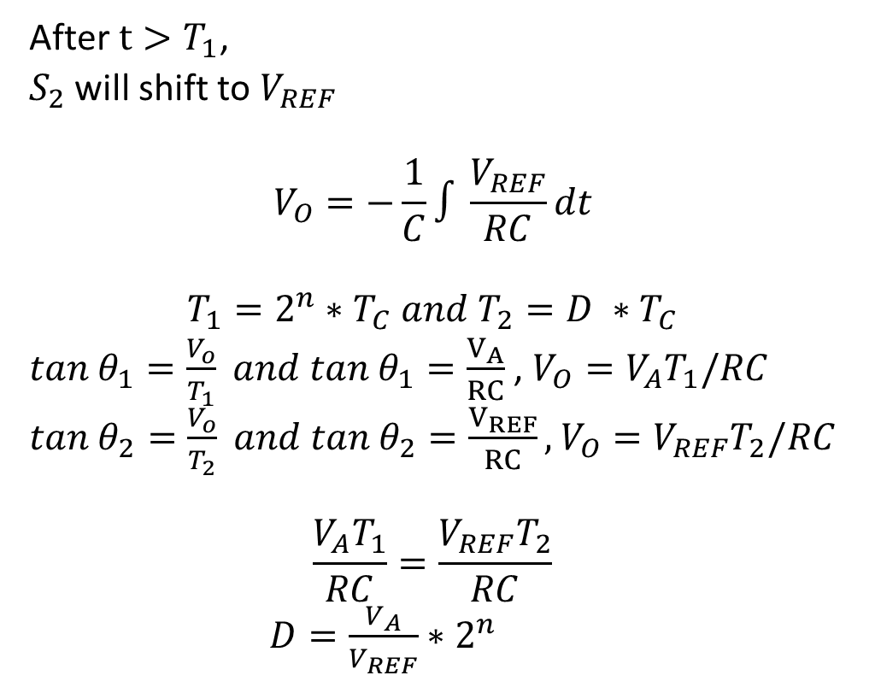
Dual Slope ADC
After $t>T_{1}$,
$S_{2}$ will shift to $V_{REF}$
$$V_{O}=−\frac{1}{C}∫\frac{V_{REF}}{RC}dt$$
$$T_{1}=2^{n}∗T_{C} and T_{2}=D ∗T_{C}$$
$tan{ θ}_{1}=\frac{V_{o}}{T_{1}} and tan{ θ}_{1}=\frac{V_{A}}{RC}$ , $V_{O}=V_{A}T_{1}/RC$
$tan{ θ}_{2}=\frac{V_{o}}{T_{2}} and tan{ θ}_{2}=\frac{V_{REF}}{RC},$ $V_{O}=V_{REF}T_{2}/RC$
$$\frac{V_{A}T_{1}}{RC}=\frac{V_{REF}T_{2}}{RC}$$
$D=\frac{V_{A}}{V_{REF}}∗2^{n}$

Slide 28
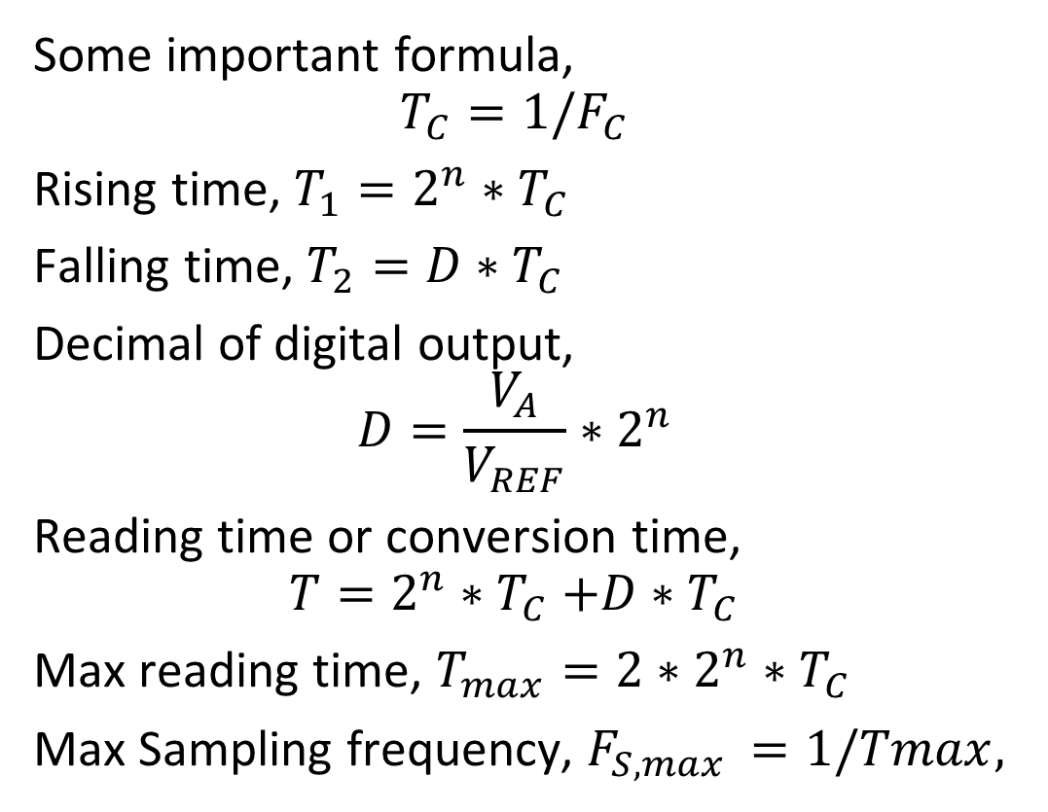
Dual Slope ADC
Some important formula,
$$T_{C}=1/F_{C}$$
Rising time, $T_{1}=2^{n}∗T_{C}$
Falling time, $T_{2}=D∗T_{C}$
Decimal of digital output,
$$D=\frac{V_{A}}{V_{REF}}∗2^{n}$$
Reading time or conversion time,
$$T=2^{n}{∗T}_{C}+D∗T_{C}$$
Max reading time, $T_{max}=2∗2^{n}∗T_{C}$
Max Sampling frequency, $F_{S,max }=1/Tmax,$

Slide 29
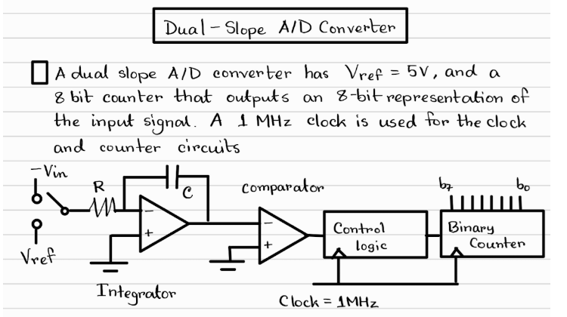

Slide 30
